Slide 1
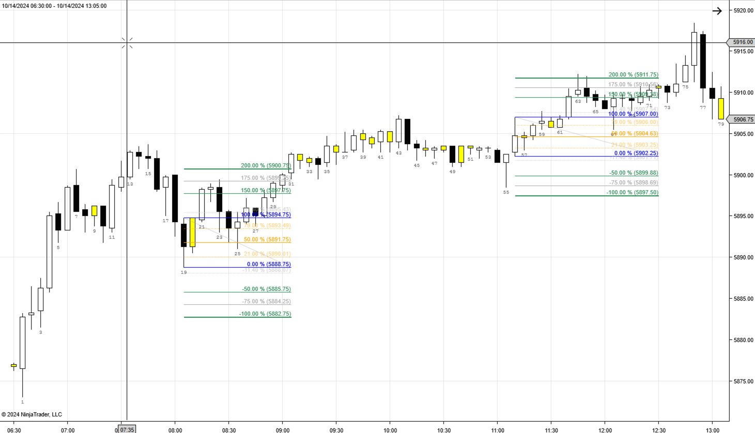
Profit Target 1 hit when price fills 5900.75 (150% OB)
Once this bar closes above 5894.75, a Limit Buy Order is placed at 5891.75
OB too small to qualify (<4pts)
Once this bar closes above 5907.00, a Limit Buy Order is placed at 5904.50 (Favor rounding)
Limit Buy Order cancelled because no new trades after 1230pm PST
OB too small to qualify (<4pts)
Limit order buy at 5891.75 filled
Stop Loss moved to 5892.00 once 5897.75 hit (100% Profit BE Level)

Slide 2
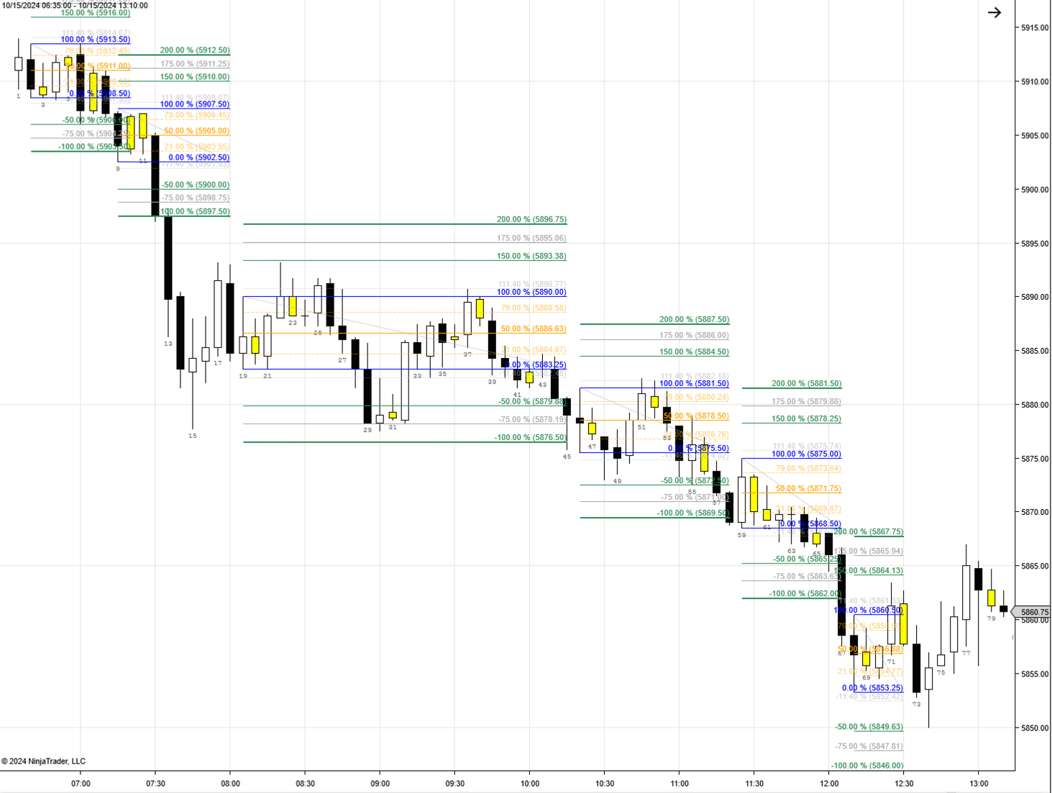
Limit Sell Order is filled at 5911.00. Profit Target at 5903.50. Stop Loss at 5918.50.
First Trade closes at BE+1tick at 5886.75.
Limit Sell Order filled at 5886.75. Profit Target at 5876.50. Stop Loss at 5896.75
Once this bar closes above 5890.00, a Limit Buy Order is placed at 5886.50 (favor)
Stop Loss moved to 5910.75 once 5906.00 hit (100% Profit BE Level)
Limit Buy Order is filled at 5886.50. Profit Target at 5896.75. Stop Loss at 5876.50
Profit Target 1 hit when price fills 5903.50 (150% OB)
Profit Target moved to 5886.50. BE+1tick (50% Loss BE Level)
Trade 2 exits at 5886.50. BE+1tick
Profit Target moved to 5878.25. BE+1tick (50% Loss BE Level)
Once this bar closes below 5908.50, a Limit Sell Order is placed at 5911.00
Once this bar closes below 5883.25, a Limit Sell Order is placed at 5886.75.
Limit Sell Order is filled at 5878.50. Profit Target at 5869.50. Stop Loss at 5887.50.
Stop Loss moved to 5878.25 once 5872.50 hit (100% Profit BE Level)
Profit Target 1 hit when price fills 5869.50 (150% OB)
Once this bar closes below 5902.50, a Limit Sell Order is placed at 5905.00
Once this bar closes below 5868.50, a Limit Sell Order is placed at 5871.75.
Profit Target moved to 5886.75. BE+1tick (50% Loss BE Level)
Once this bar closes Limit Sell Order at 5886.75 is cancelled b/c new OB qualifies
Once this bar closes Limit Sell Order at 5868.50 is cancelled b/c new OB qualifies
Once this bar closes Limit Sell Order at 5905.00 is cancelled b/c new OB qualifies
Once this bar closes below 5883.25, a Limit Sell Order is placed at 5886.75.
Once this bar closes below 5875.50, a Limit Sell Order is placed at 5878.50.
Once this bar closes below 5875.50, a Limit Sell Order is placed at 5878.50.
Limit Sell Order is filled at 5878.50. Profit Target at 5869.50. Stop Loss at 5887.50.
Once this bar closes above 5860.50, a Limit Buy Order is placed at 5856.50.
Open order at 5856.50 cancelled at 1230pm PST

Slide 3
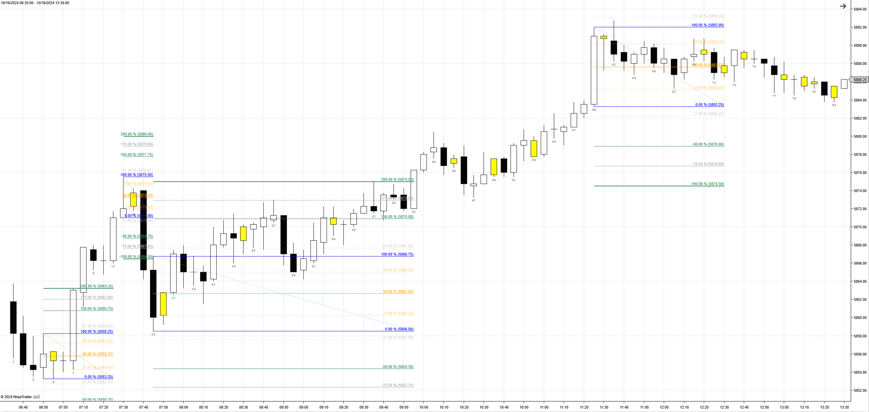
Profit Target 1 hit when price fills 5875.00 (150% OB).
NOTE: In this instance, if Profit is a Limit order, it would fill either on Candle 37 or 41. If Profit target is MIT order, it would trigger on candle 37
Once this bar closes a new OB qualifies and Limit Buy Order at 5855.75 is cancelled.
Once this bar closes below 5871.00 a Limit Sell Order is placed at 5873.25
Stop Loss moved to BE Level of 5862.75 once 5870.75 hit (100% Profit BE Level)
No orders placed because, no bars closed outside OB before 1230pm PST
Once this bar closes above 5858.25, a Limit Buy Order is placed at 5855.75
OB too small to qualify (<4pts)
Limit Buy Order at 5862.50 fills and Profit Target 1 is placed at 5875.00 and Stop Loss is placed at 5850.25
Once this bar closes above 5866.75, a Limit Buy Order is placed at 5862.50 (rounded in favor)
Once this bar closes a new OB qualifies and Limit Sell Order at 5873.25 is cancelled.

Slide 4
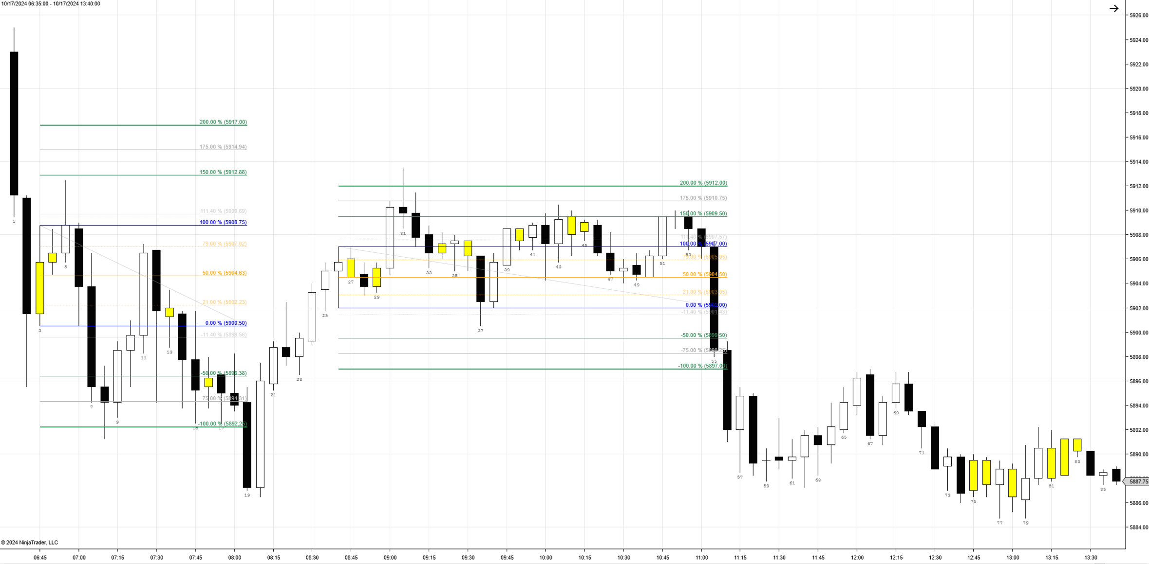
Size of OB is too big (<9.5pts) so not a valid trading setup. However, there is another IB here and that one qualifies. So Bar 2 is too big, but bar 3 qualifies
Limit Buy Order is filled at 5904.50. Profit Target at 5912.00. Stop Loss at 5897.00..
Stop Loss moved to BE Level of 5904.75 once 5909.50 hit (100% Profit BE Level)
Limit Buy Order is filled at 5904.50. Profit Target at 5912.00. Stop Loss at 5897.00.
Once this bar closes above 5907.00, a Limit Buy Order is placed at 5904.50
Once this bar closes above 5907.00, a Limit Buy Order is placed at 5904.50
Once this bar closes above 5907.00, a Limit Buy Order is placed at 5904.50
Limit Sell Order is filled at 5904.75. Profit Target at 5892.25. Stop Loss at 5917.00.
Limit Buy Order is filled at 5904.50. Profit Target at 5912.00. Stop Loss at 5897.00.
Profit Target moved to BE Level of 5904.75 once 5902.00 hit (50% Loss BE Level)
Profit Target moved to BE Level of 5904.75 once 5902.00 hit (50% Loss BE Level)
BE Level of 5904.75 filled
Stop Loss 1 hit when price fills 5897.00 (150% OB).
BE Level of 5904.75 filled
Once this bar closes below 5900.50 a Limit Sell Order is placed at 5904.75 (round in favor)
Stop Loss moved to BE Level of 5904.50 once 5896.25 hit (100% Profit BE Level)
Profit Target 1 hit when price fills 5892.25 (150% OB).
No qualifying OB’s because after 1230pm PST

Slide 5
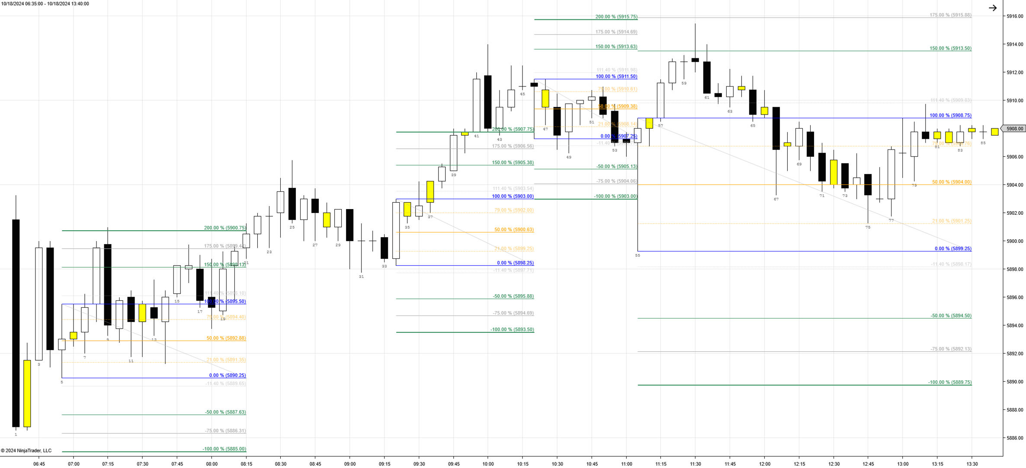
Once this bar closes above 5908.75, a Limit Buy Order is placed at 5904.00
Size of OB is too big (<9.5pts) so not a valid trading setup.
Once this bar closes a new OB qualifies and Limit Buy Order at 5900.50 is cancelled.
Long is closed at market order at 130pm (Auto-Close Positions)
Once this bar closes above 5895.50, a Limit Buy Order is placed at 5892.75 (favor)
Once this bar closes above 5903.00, a Limit Buy Order is placed at 5900.50 (favor)
Stop Loss moved to BE Level of 5893.00. once 5898.00 hit (100% Profit BE Level)
Profit Target 1 hit when price fills 5900.75 (150% OB).
Once this bar closes a new OB qualifies and Limit Sell Order at 5909.50 is cancelled.
Once this bar closes below 5907.25, a Limit Sell Order is placed at 5909.50 (favor)
Limit Buy Order is filled at 5904.00. Profit Target at 5918.25. Stop Loss at 5889.75
OB too small to qualify (<4pts)
Limit Buy Order is filled at 5892.75. Profit Target at 5900.75. Stop Loss at 5885.00

